Slide 1
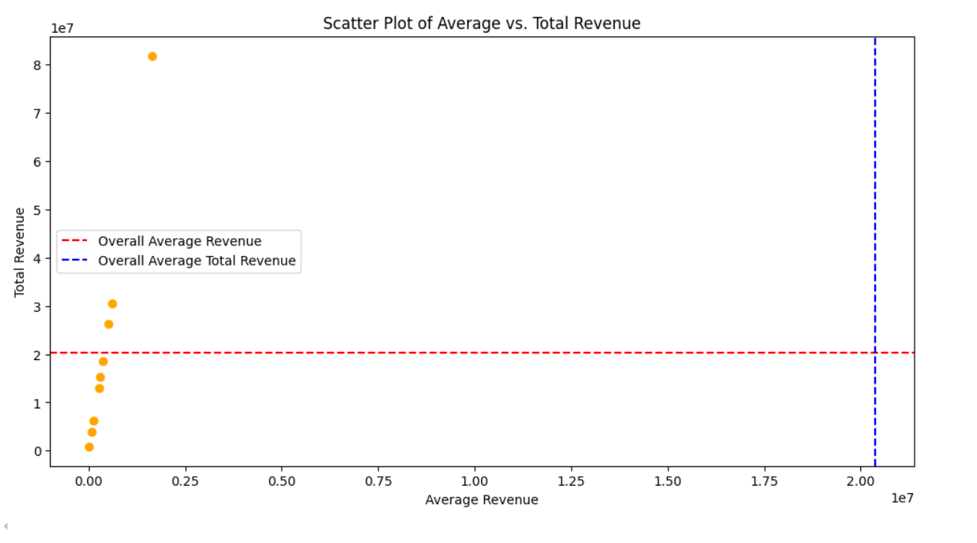
Notes:
This scatter plot compares the average revenue per playlist against the total revenue for each artist, revealing correlations or outliers in their revenue performance.

Slide 2
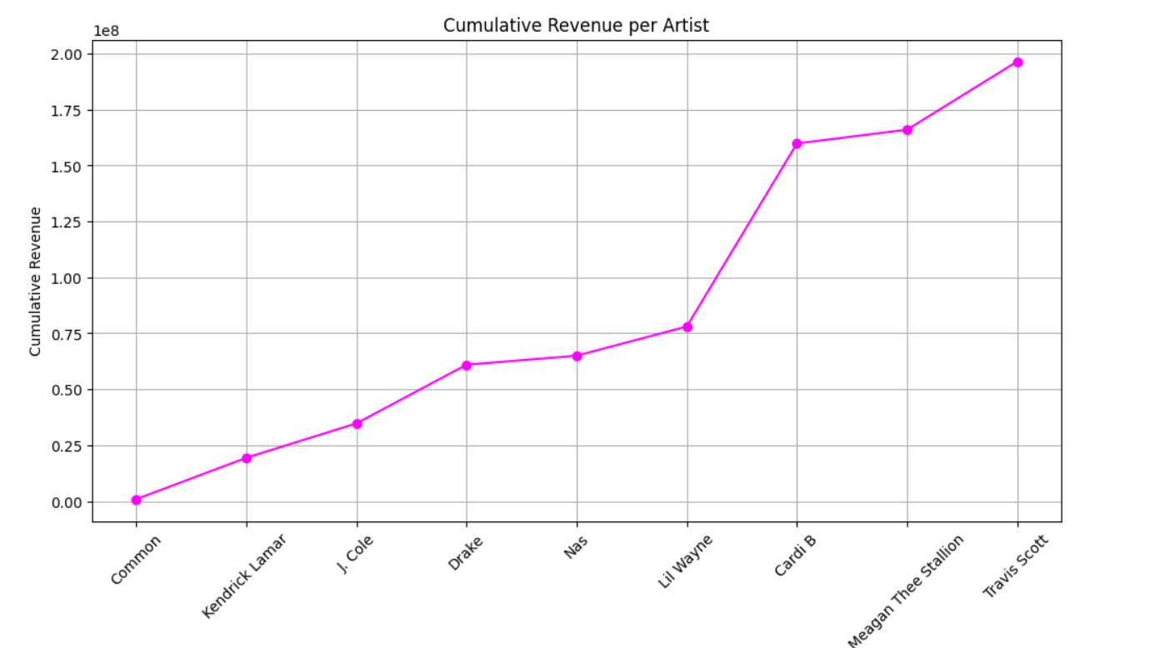
Notes:
This line graph shows the total accumulated revenue for each artist, providing a clear comparison of overall earnings.

Slide 3
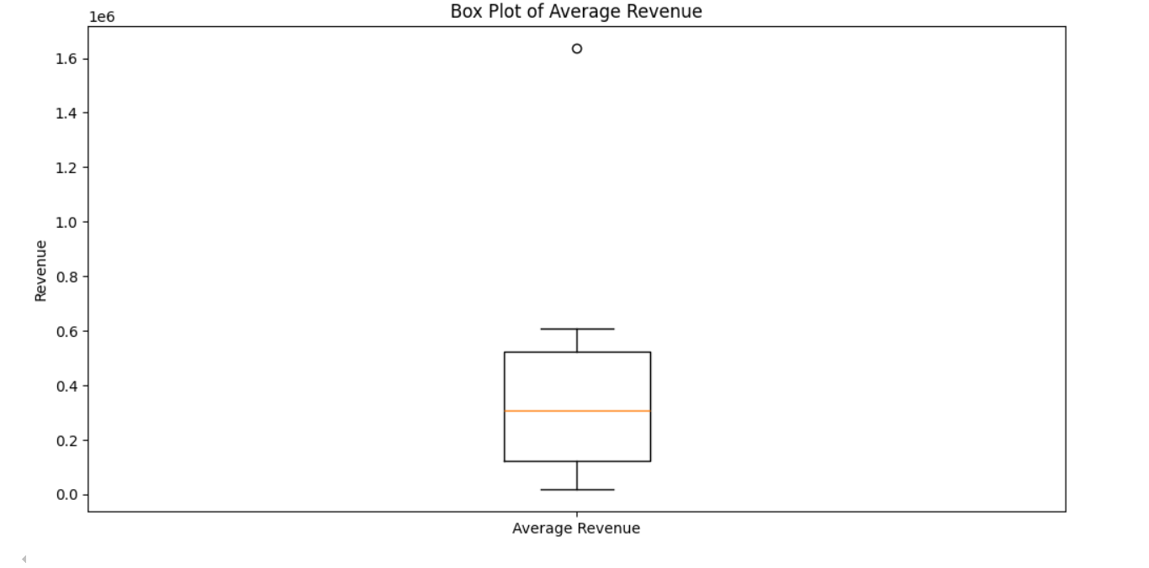
Notes:
This boxplot displays the spread and variability of total revenue across different artists, showing the range, median, and outliers in their earnings.

Slide 4
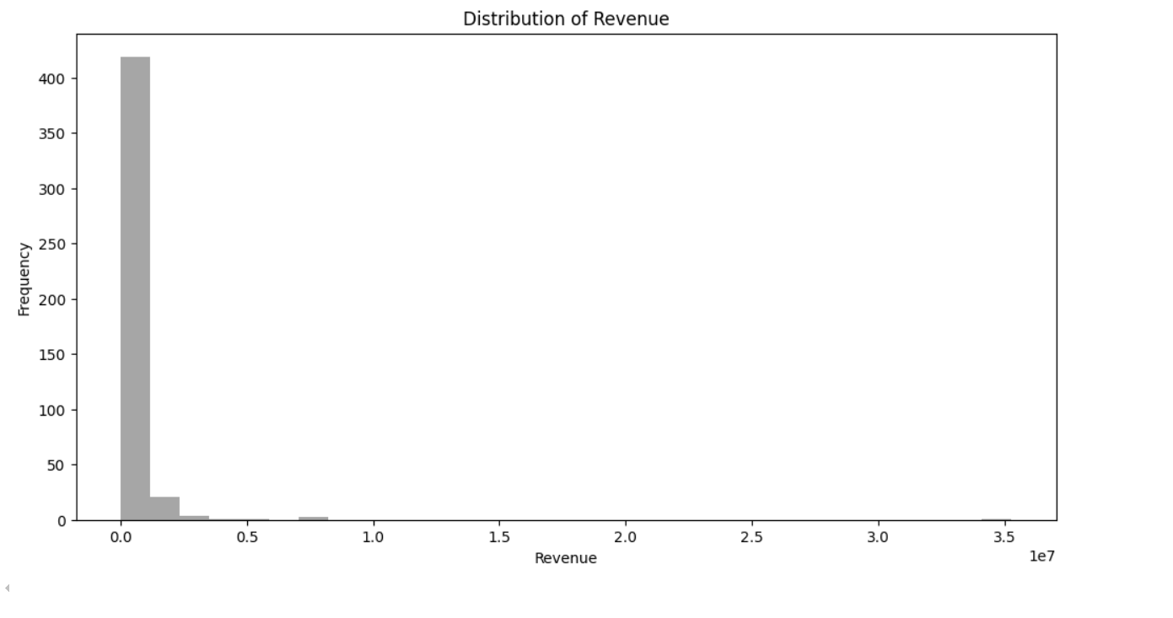
Notes:
This distribution plot visualizes the spread and variability of revenue across different playlists, offering insights into the consistency or disparity in revenue generation.

Slide 5
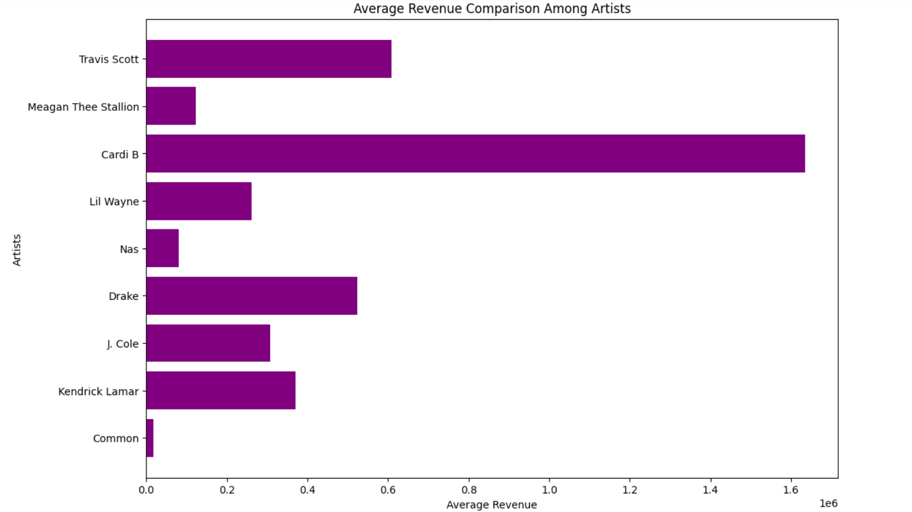
Notes:
This histogram compares the distribution of revenue values for each artist, highlighting variations in revenue levels and identifying which artists have more frequent occurrences of higher or lower revenue.

Slide 6
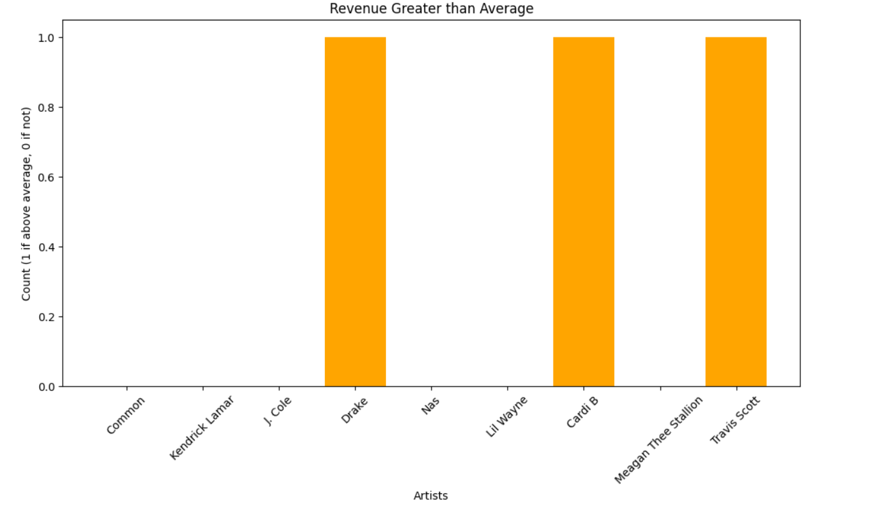
Notes:
This bar chart displays the total revenue for each artist that exceeds the overall average revenue, showing which artists consistently perform above the expected level.

